Slide 1

• Department of Public Health & Social Services • Department of Mental Health & Substance Abuse • Health Partners, LLC •
UOG Caner Research Center U54 Pilot Project 1 (Community Outreach)
Notes:
1

Slide 2

Before We Begin
Let’s introduce ourselves.
What do you hope to gain from the experience?
Working towards a healthier,
Tobacco free future for Guam

Slide 3
Before We Begin
Materials
  Training Manual
  Exercise – Stages of readiness
  Flow chart, Tip sheets, Problem solving sheets, Quit plan and medication cards
Requirements
  Registration form
  Pre and post test/confidence assessment
  Skills checklist
  Final examination – at least 80%
  Evaluation form

Slide 4
Before We Begin
Introduction
Remember:
  Don’t be discouraged by people who fail to quit.
  Many tobacco users have other substance addictions.
  Be aware of how you present yourself.
  Be aware of the physical and social environment that “frames” your cessation message.
  Use local resources!

Slide 5
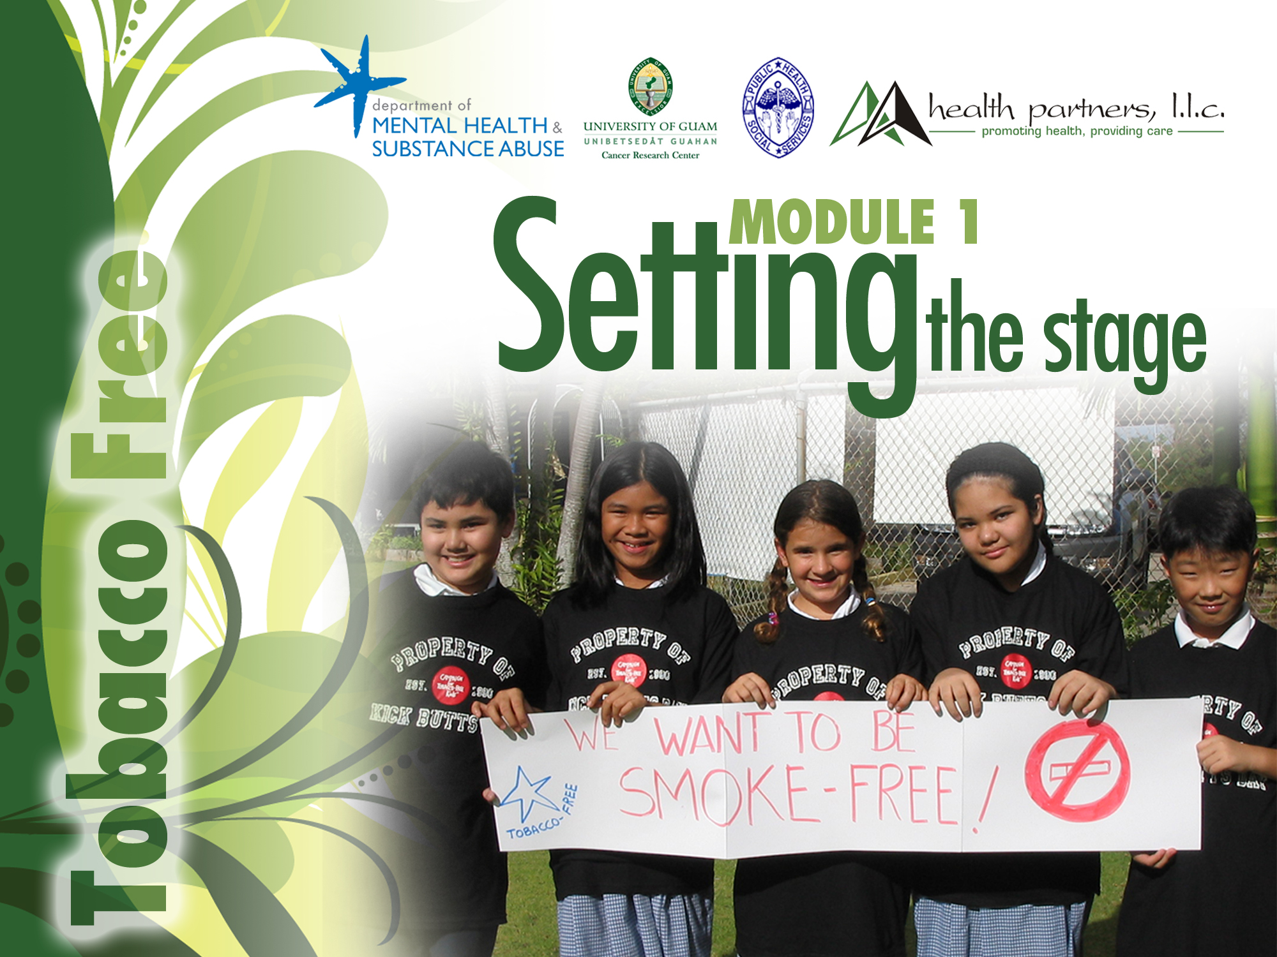
• Department of Public Health Service • Department of Mental Health & Substance Abuse
• Health Partners, LLC • University of Guam Cancer Research Center U54 Pilot Project 1 (Community Outreach)

Slide 6
Module 1: Setting the Stage
Learning Objectives and Goals:
Use the Basic Tobacco Intervention Skills Guidebook as a learning tool;
Have a clear understanding of the goals for the learner;
Recognize the different levels of intensity in tobacco interventions.

Slide 7
Levels of Intensity in Tobacco Interventions
Minimal Intervention:
Less than three minutes
Brief Intervention: Lasts 3 to 10 minutes
Intensive Intervention:
  Trained (preferably certified) provider
  Four or more sessions - longer than 10 minutes
  Total contact/session - longer than 30 minutes
  Over at least 2 weeks; preferably 8 or more weeks
  Includes education on medical treatment

Slide 8
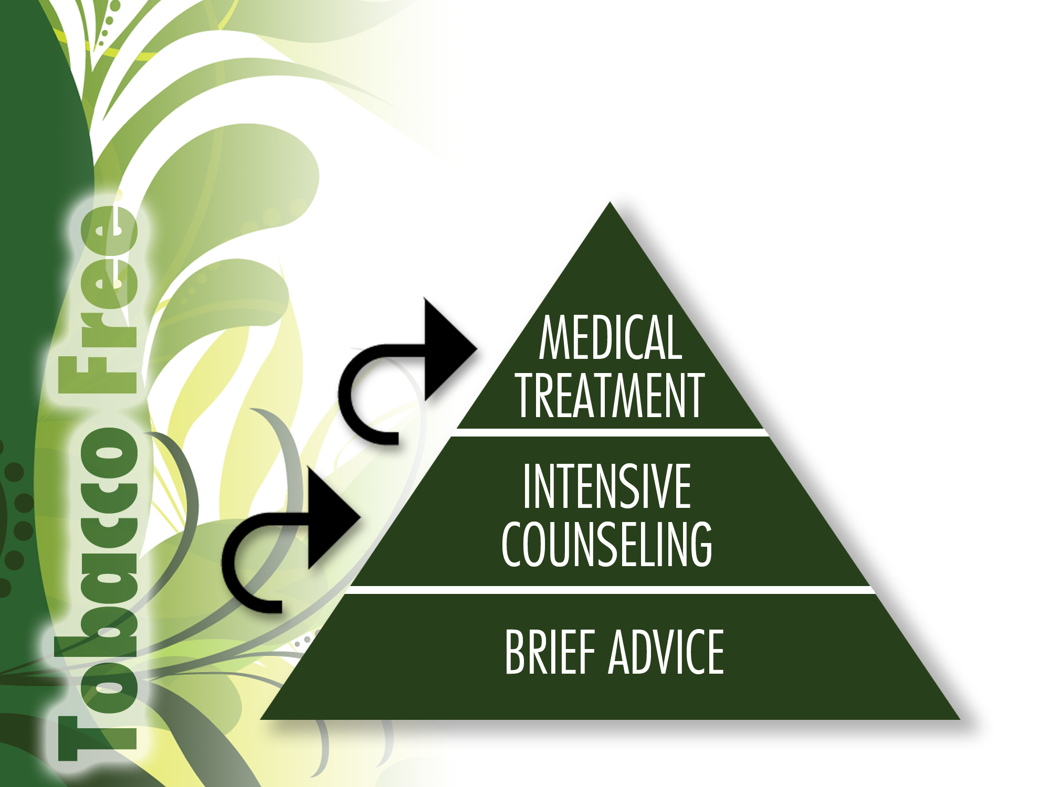
Building a Cessation System

Slide 9
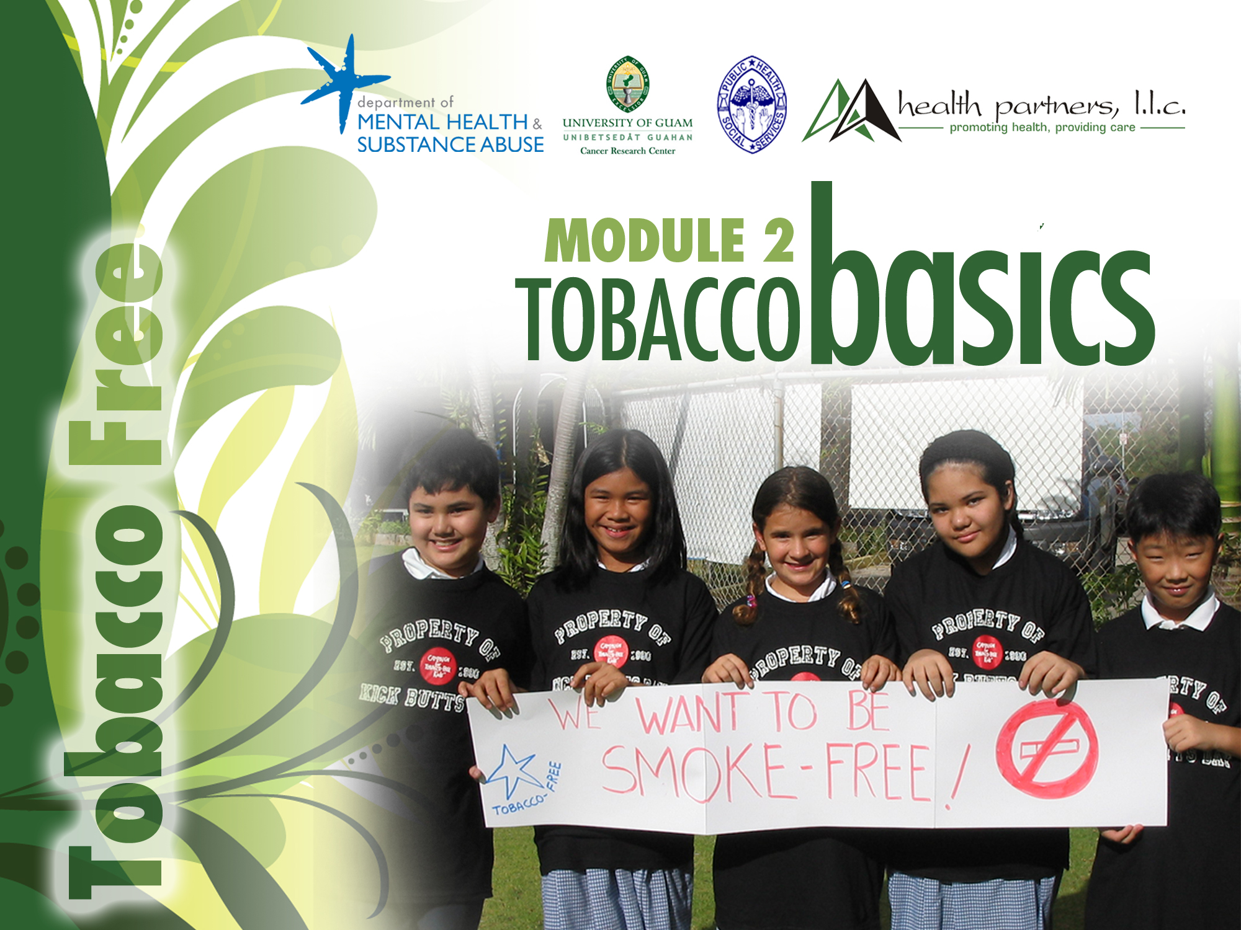
• Department of Public Health Service • Department of Mental Health & Substance Abuse
• Health Partners, LLC • University of Guam Cancer Research Center U54 Pilot Project 1 (Community Outreach)

Slide 10
Module 2 - Tobacco Basics
Learning Objectives and Goals
Learn about tobacco-related statistics in Guam;
Describe the biological, psychological and socio-cultural components of tobacco dependence;
Relate the information presented in this module to your own experience.

Slide 11
Video Break
Why is tobacco a problem?

Slide 12
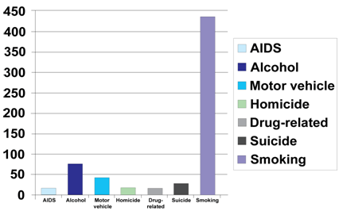
Comparative Causes of Annual Deaths in the U.S.
$193B
Sources: (AIDS) HIV/AIDS Surveillance Report, 1998; (Alcohol) McGinnis MJ, Foege WH. Review: Actual Causes of Death in the United States. JAMA 1993;270:2207-12; (Motor vehicle) National Highway Transportation Safety Administration, 1998; (Homicide, Suicide)
12
Notes:
Tobacco use is the chief preventable cause of illness and death in our society, responsible for more than 400,000 deaths in the U.S. each year. (Fiore, 1996)
The cost of lost productivity and forfeited earnings due to smoking-related disability exceeds $80 billion per year.

Slide 13
Smoking, Adults, Guam vs. US
Source: BRFSS 2010, DPHSS
Smoking among adults remains on Guam remains higher than average.
Over 1 in 4 adults smoke.
Red flag:
Smoking prevalence is about 50% higher on Guam than in the US.
Source: DPHSS BRFSS 2001-2010
Working towards a healthier,
Tobacco free future for Guam
Notes:
Smoking among adults remains unchanged on Guam from 2003.
About 1 in 3 adults smokes.
Smoking prevalence is about 36% higher on Guam than in the US.
13

Slide 14
Smoking, Adults, by Sex
Regardless of sex, smoking is higher on Guam than in the US
Male smoking on Guam is almost double the rate of the US.
Female smoking on Guam is higher than the male smoking rate of the US.
Source: DPHSS BRFSS 2001-2010
Notes:
Smoking among males on Guam is nearly 40% higher than among females, unlike in the US, where male and female smoking are about the same.
Smoking among females on Guam is 20% higher than among females in the US.
14

Slide 15
Tobacco Use by
Income, Adults, Guam 2010
Smoking varies with income and education
Source: DPHSS BRFSS 2001-2010
Working towards a healthier,
Tobacco free future for Guam
Notes:
15

Slide 16
Quit attempts, Adults
Statistically significant increase in percent of smokers who attempted to quit at least one day in the past year
Source: DPHSS BRFSS 2010
Working towards a healthier,
Tobacco free future for Guam
Notes:
16

Slide 17
Consequences: CANCER
Top Causes of Cancer Death on Guam 2003-2007
Males | Females
Lung and Bronchus* | Lung and bronchus*
Prostate | Breast***
Colon and Rectum* | Colon and Rectum*
Liver * | Cervix*
Nasopharynx** | Non-Hodgkin’s Lymphoma
* Related to smoking
**Related to chewing tobacco
***Related to second hand smoke exposure
Working towards a healthier,
Tobacco free future for Guam
Notes:
17

Slide 18
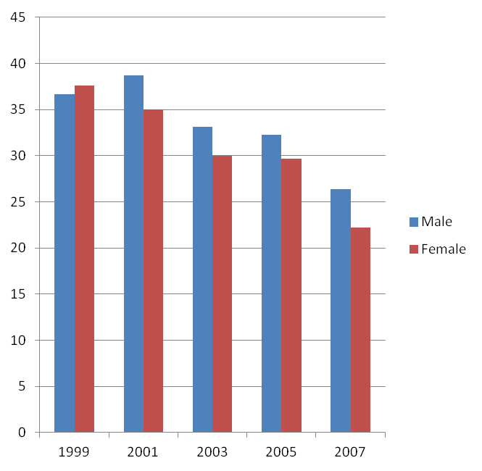
Current smoking by sex, Youth
High School
Middle School
Source: GDOE YRBS 1999-2007
Working towards a healthier,
Tobacco free future for Guam
Notes:
18

Slide 19
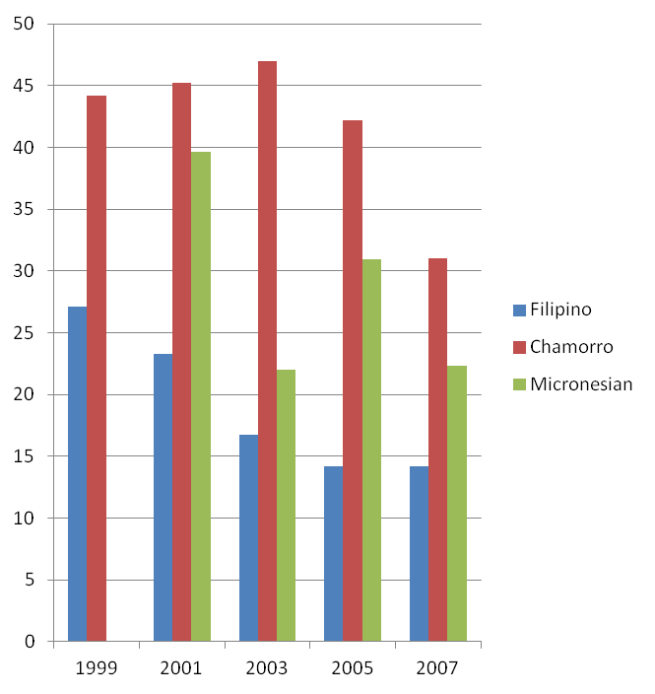
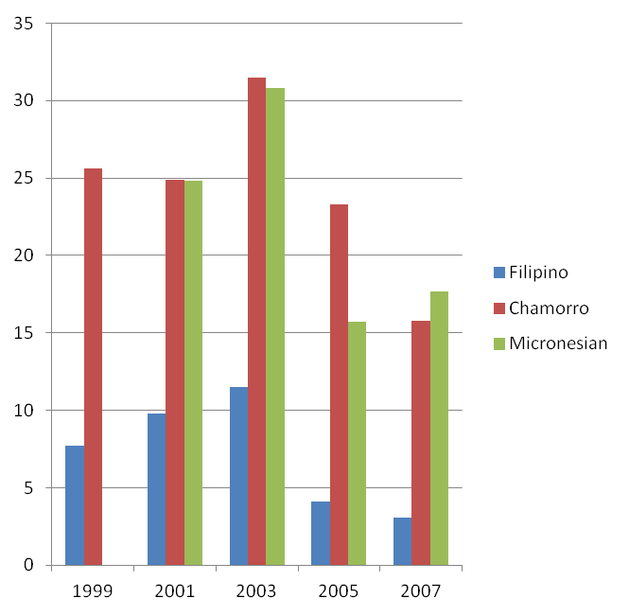
Current Smoking, Youth, by Ethnicity
High School
Middle School
Working towards a healthier,
Tobacco free future for Guam
Source: GDOE YRBS 1999-2007
Notes:
19

Slide 20
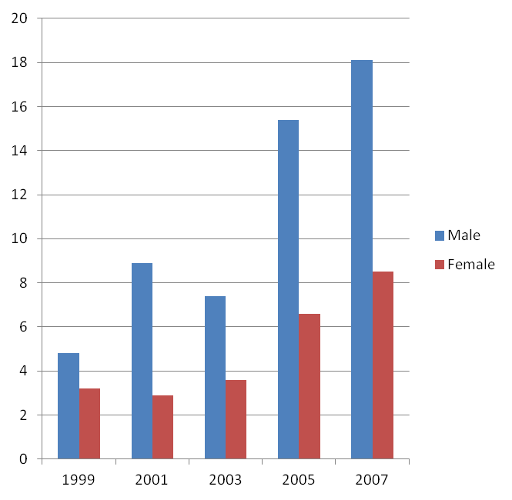
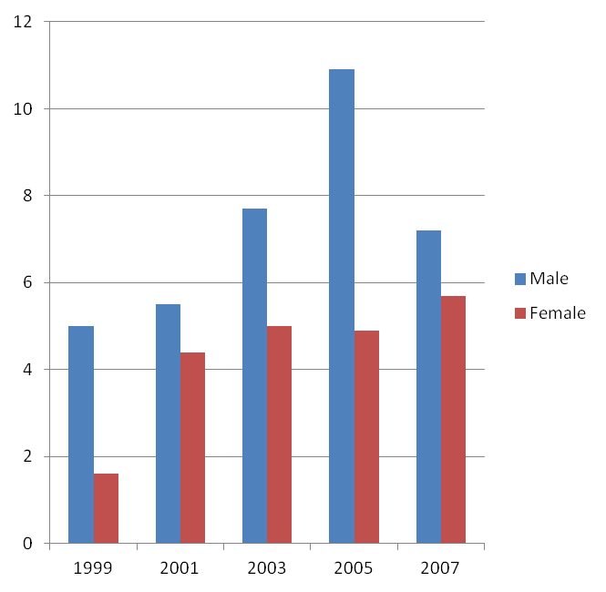
Smokeless Tobacco Use, Youth, by Sex
High School
Middle School
Working towards a healthier,
Tobacco free future for Guam
Source: GDOE YRBS 1999-2007
Notes:
20

Slide 21
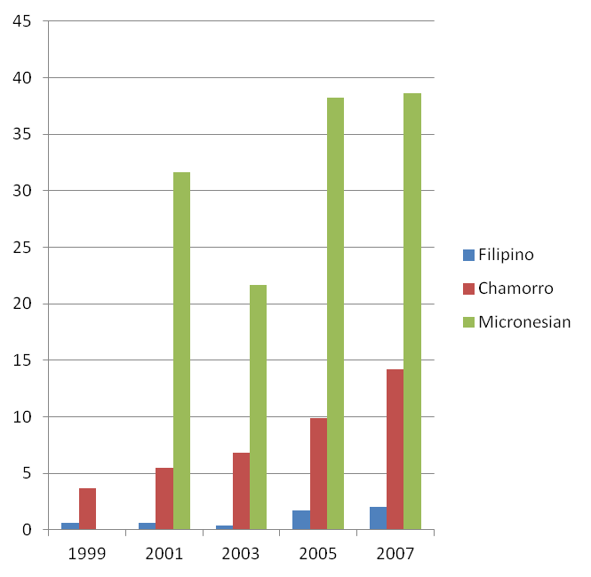
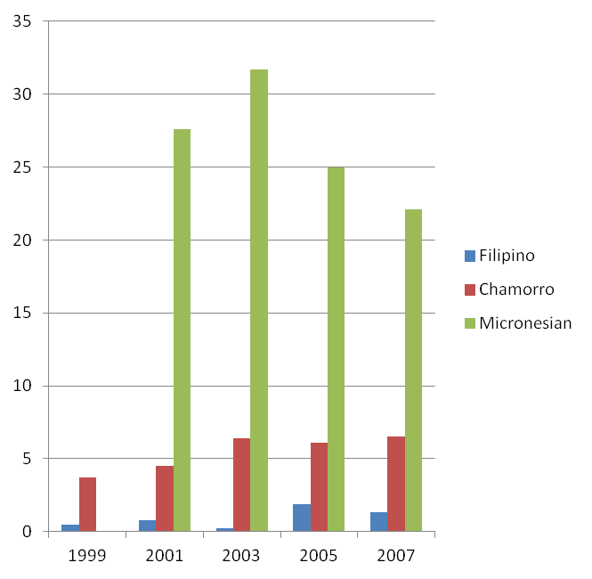
Smokeless Tobacco Use,
Youth, by Ethnicity
High School
Middle School
Working towards a healthier,
Tobacco free future for Guam
Source: GDOE YRBS 1999-2007
Notes:
21

Slide 22
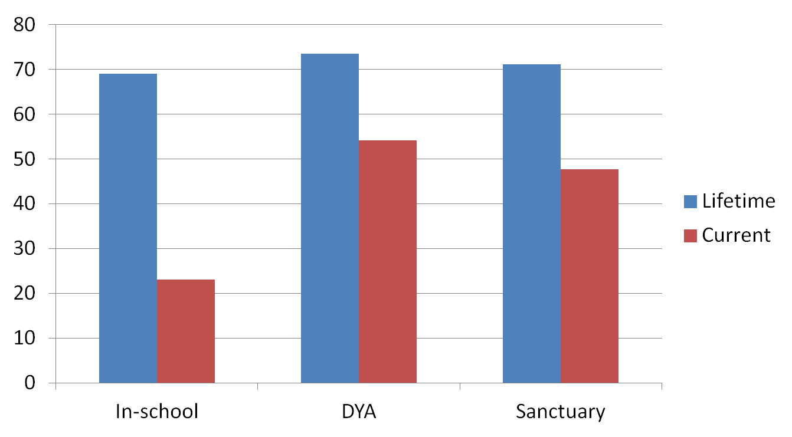
Lifetime and current smoking, Youth
Working towards a healthier,
Tobacco free future for Guam
Sources: GDOE YRBS 2007;
DMHSA SEOW data 2009
Notes:
22

Slide 23
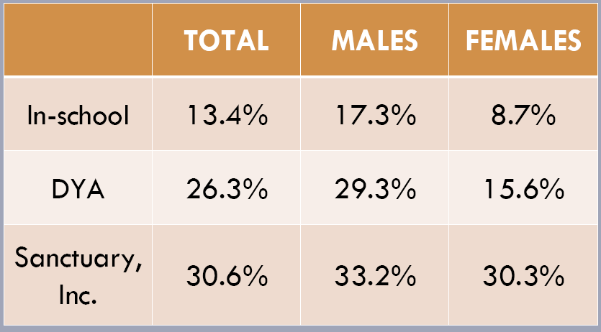
Other tobacco use, Youth
Working towards a healthier,
Tobacco free future for Guam
Sources: GDOE YRBS 2007;
DMHSA SEOW data 2009
Notes:
23

Slide 24
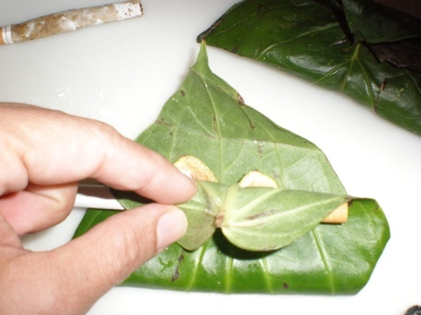
Q-Mark Survey 2008, DMHSA
Overall, 6% of youth respondents chew pugua
24% of Micronesian students chew pugua regularly
Among those who chew pugua:
Pugua Use | %
By itself | 52%
With pepper/pupulu | 48%
Lime | 64%
Tobacco | 44%
4% of students report having tried chewing tobacco, snuff or dip.
Working towards a healthier,
Tobacco free future for Guam
Source: DMHSA SEOW data 2009
Notes:
24

Slide 25
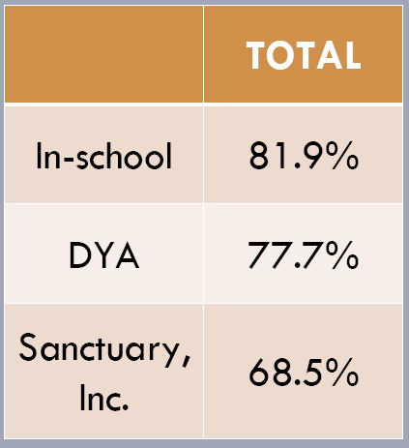
Quit attempts
Lifetime smoking – no difference
Current smoking – markedly higher among DYA and Sanctuary youth
Quit attempts – lower among DYA and Sanctuary youth
Sources: GDOE YRBS 2007;
DMHSA SEOW data 2009
Working towards a healthier,
Tobacco free future for Guam
Notes:
25

Slide 26
Video Break
Three-Link Chain of Tobacco Dependence
Biological Dependence
Psychological Dependence
Socio-cultural Factors

Slide 27
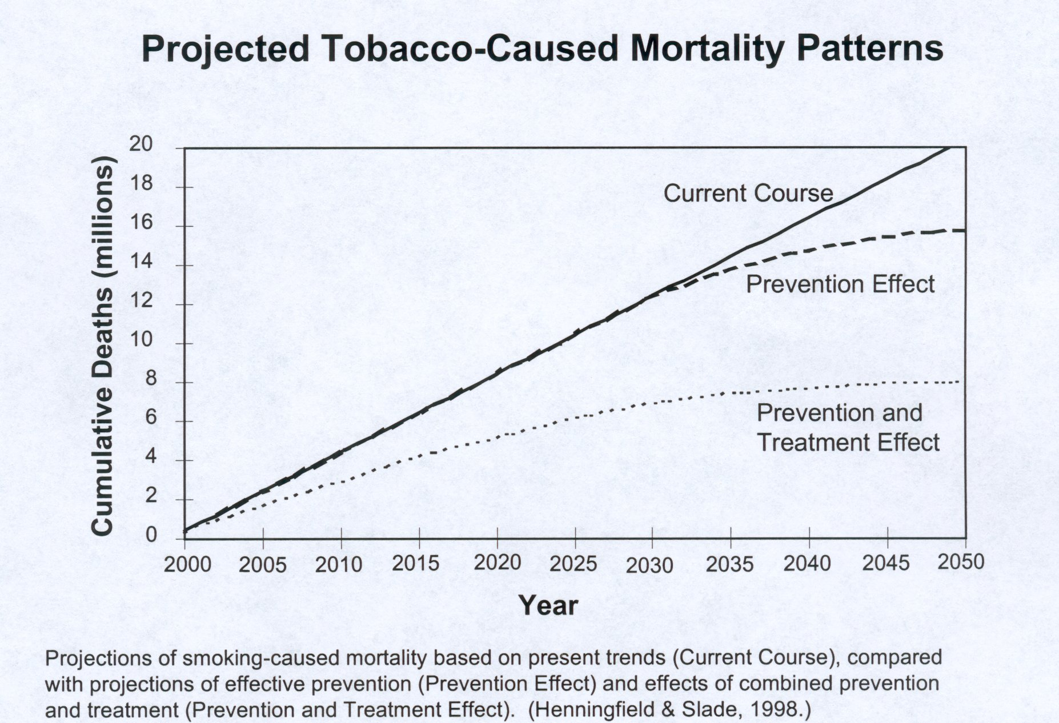
The Need for Treatment

Slide 28
Learning Activity
Let’s hear your views
and learn from your
experiences.

Slide 29
Tobacco Basics
Knowledge is not enough.
You do make a difference!
  Substantial evidence that brief tobacco dependence treatment is effective.
  VIDEO BREAK

Slide 30
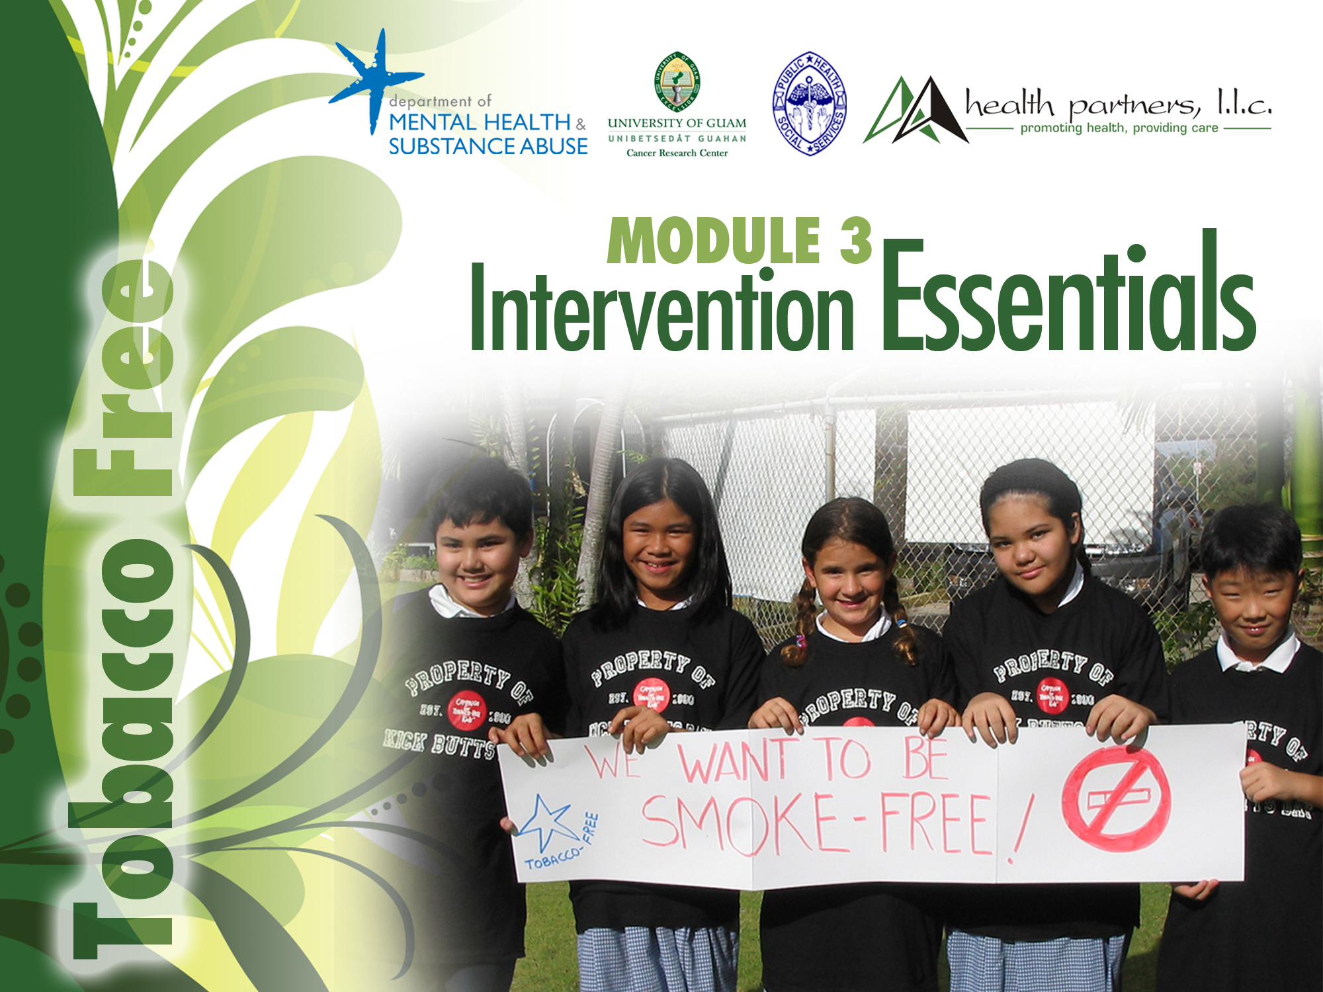
• Department of Public Health Service • Department of Mental Health & Substance Abuse
• Health Partners, LLC • University of Guam Cancer Research Center U54 Pilot Project 1 (Community Outreach)

Slide 31
Module 3 - Intervention Essentials
Learning Objectives and Goals:
Identify a person’s readiness to quit, using the “Readiness to Change” model;
Name the “Five A’s” and give a brief explanation to each;
Identify the contents of the Brief Intervention Flow Chart.

Slide 32
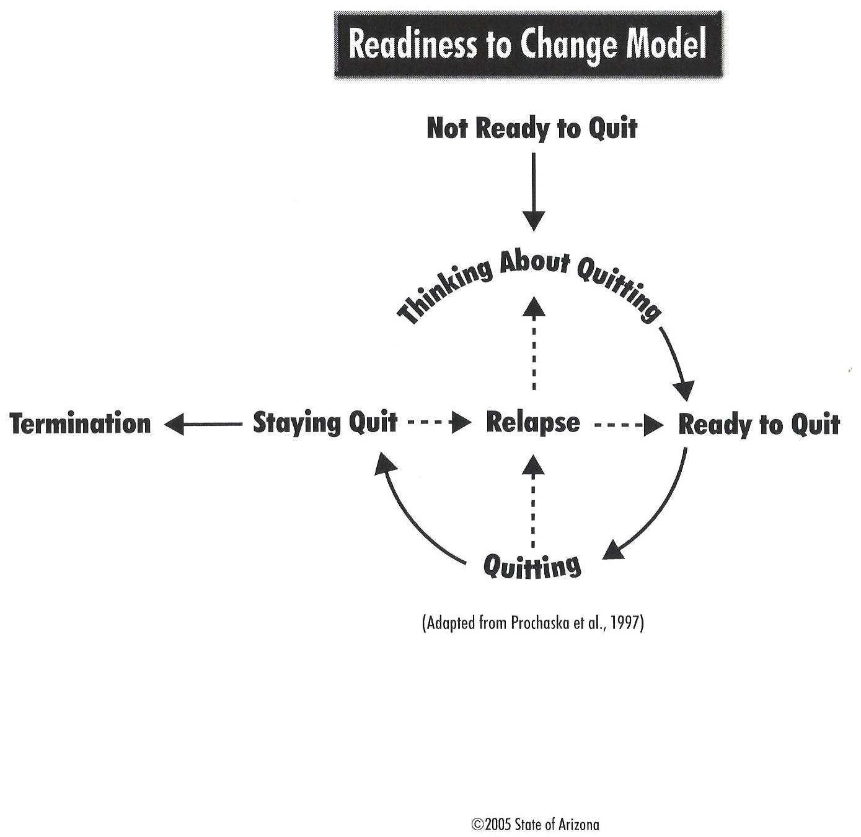
Readiness to Change Model
Not ready to quit
Thinking about quitting
Ready to quit
Quitting
Staying quit
*Relapse

Slide 33
Spot Quiz
Match the characters described
in the work sheet to their stage
of readiness to quit using
tobacco.
(OPEN BOOK)

Slide 34
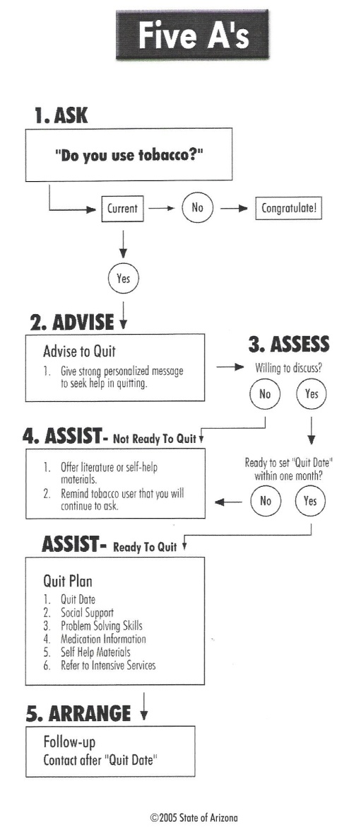
The Five A’s
Ask
Advise
Assess
Assist
Arrange
*Anticipate

Slide 35
ASK
Ask about tobacco use at EVERY encounter.
For health facilities: tobacco use as a “vital sign”
Keep it simple:
  Do you use tobacco?
  Does anyone else in your home use tobacco?

Slide 36
ADVISE
Urge EVERY tobacco user to quit.
Remember the 5 “Rs”:
  Relevant
  Risks
  Rewards – refer to the “Benefits of Quitting” sheet
  Roadblocks
  Repetition

Slide 37
ASSESS
Determine the tobacco user’s willingness to make a quit attempt.
Within the next 30 days
If willing, ASSIST.
If not willing, provide non-judgmental support and information to get the person thinking about quitting - “Benefits of Quitting” hand-out.

Slide 38
ASSIST
Assist the tobacco user in quitting.
Develop a Quit Plan:
  Set a quit date.
  Identify social support.
  Provide specific problem-solving suggestions.
  Give information on medications.
  Provide self-help materials.
  Refer for intensive counseling, if appropriate.

Slide 39
ARRANGE
Arrange for follow-up whenever possible.
For tobacco users about to make a quit attempt, arrange follow-up around 1 week after the quit attempt:
  Ask about tobacco status.
  Congratulate those who are tobacco-free and encourage them to stay quit.
  Support those who have relapsed and assist them to make a new quit attempt.

Slide 40
ANTICIPATE*
For children and adolescents:
Anticipate exposure to tobacco smoke and early experimentation with chewing or smoking tobacco.
Beginning around age 10, ask about:
  Exposure to second hand smoke
  Actual tobacco use
  At every clinical encounter

Slide 41
FLOW CHART
Review the flow chart provided to remind you of the “five A’s”.

Slide 42
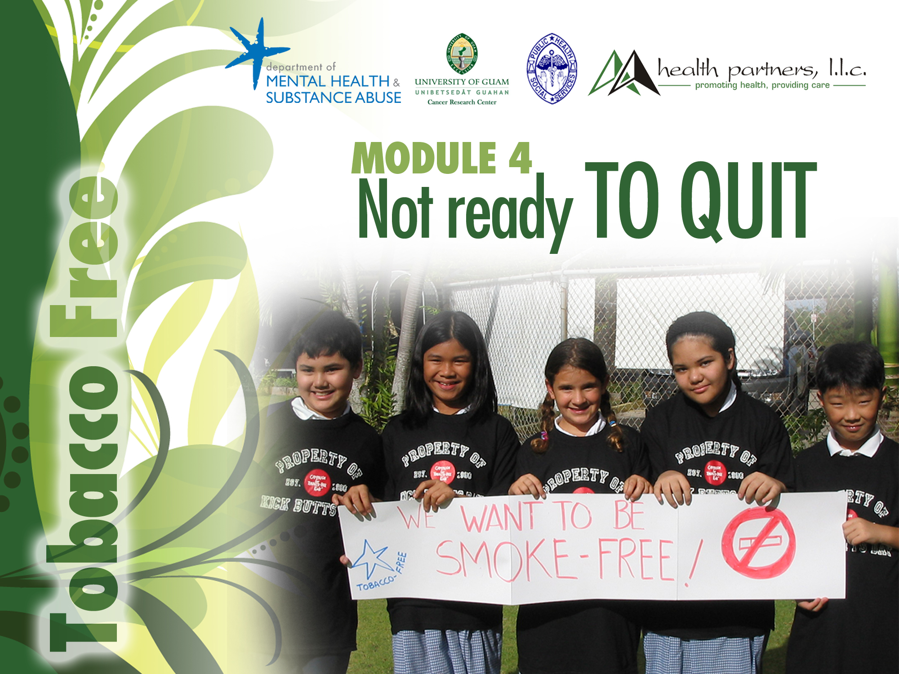
• Department of Public Health Service • Department of Mental Health & Substance Abuse
• Health Partners, LLC • University of Guam Cancer Research Center U54 Pilot Project 1 (Community Outreach)

Slide 43
Module 4 – Not Ready to Quit
Learning Objectives and Goals
Identify tobacco users who are not ready to quit;
Name the “Five A’s” and give a brief explanation of how each applies to individuals not ready to quit.

Slide 44
Not Ready to Quit
ASK
ADVICE
ASSESS – “Are you ready to set a quit date within the next 30 days?” “NO.”

Slide 45
NOT READY TO QUIT
A brief intervention with someone who is not yet ready to quit may be very short, perhaps only 30 seconds long.
DON’T try to convince the person to quit.
ASSIST – by offering info and educational materials that describe the benefits of quitting and the consequences of tobacco use.
ARRANGE – follow-up and let them know you will be available when they are ready to quit

Slide 46
Video Demo and Practice
The Readiness to Change Model
  Not Ready to Quit

Slide 47
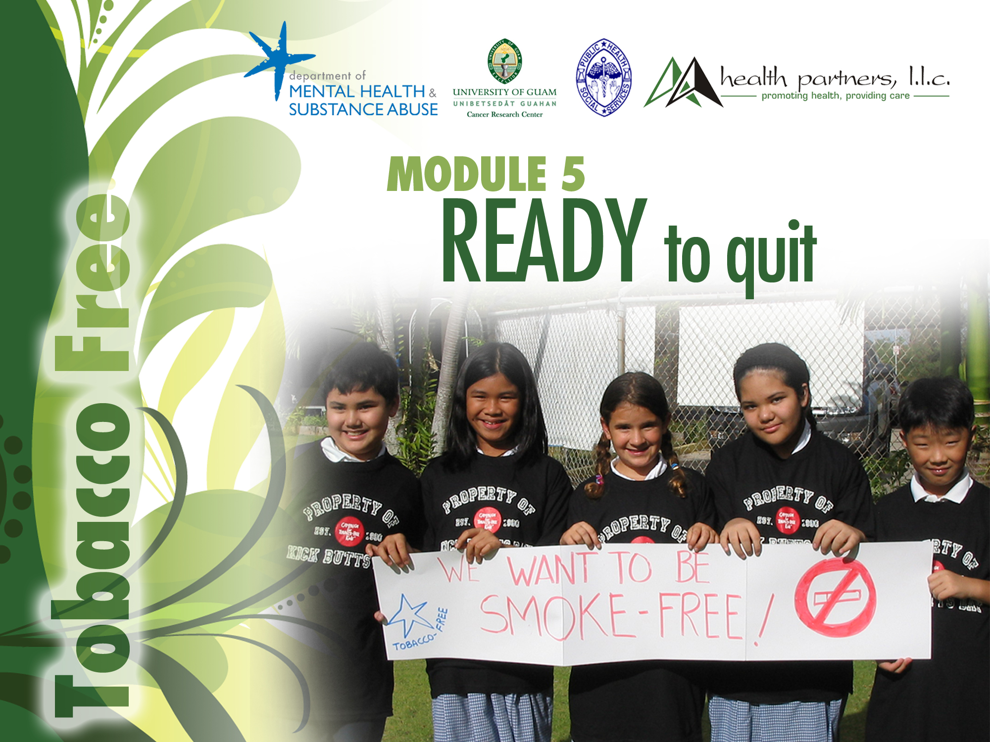
• Department of Public Health Service • Department of Mental Health & Substance Abuse
• Health Partners, LLC • University of Guam Cancer Research Center U54 Pilot Project 1 (Community Outreach)

Slide 48
Module 5 – Ready to Quit
Learning Objectives and Goals:
Identify tobacco users who are ready to quit – within the next 30 days;
Name the “Five A’s” and apply these to a person who is ready to quit using tobacco;
Name the 6 basic elements of a Quit Plan;
Locate/use the tools in the Guidebook;
Use the Flow Chart to guide you.

Slide 49
Ready to Quit
ASK
ADVICE
ASSESS – “Are you ready to set a quit date within the next 30 days?” “YES.”

Slide 50
ASSIST
6 Basic Elements of a Quit Plan
Quit Date
Social Support
Problem Solving Skills
Medication Information
Self-help Materials
Referral to Other Programs or Services

Slide 51
Self-Help Materials
Benefits of Quitting
Quit Plan
Problem solving Sheet –Before Quitting
Problem solving Sheet – After Quitting
Medication cards – for ADULTS who are considering medical help; always refer to their doctor!
Quit Smoking resources – Always refer to intensive counseling for help.

Slide 52
Pharmacological treatment
Nicotine replacement - “methadone for the smoker”
  gum
  patches
  nasal spray
  inhaler
Bupropion – “Zyban”; also now “Chantix”
All decrease cravings, withdrawal
Up to ~30% quit rates at 1 year

Slide 53
Nicotine replacement and buproprion should always be used in conjunction with behavior modification.

Slide 54
Video Demo Practice
The Readiness to Change Model
  Ready to Quit

Slide 55
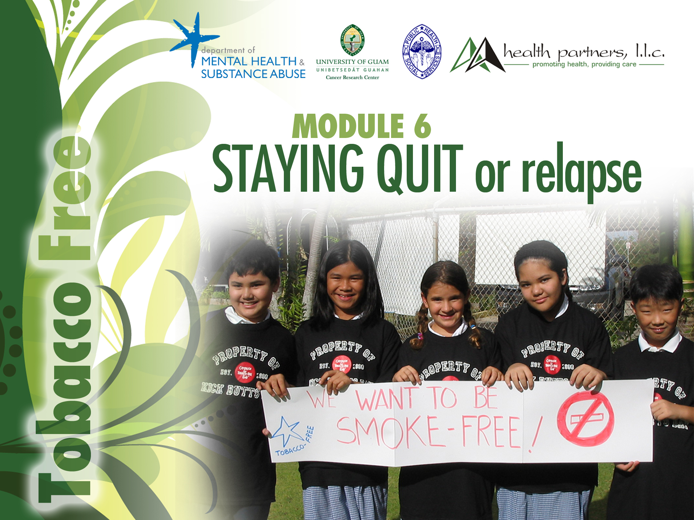
• Department of Public Health Service • Department of Mental Health & Substance Abuse
• Health Partners, LLC • University of Guam Cancer Research Center U54 Pilot Project 1 (Community Outreach)

Slide 56
Module 6 – Staying Quit or Relapse
Learning Objectives and Goals
Identify a person’s tobacco use status and readiness to change during a follow-up;
Identify at least 2 reasons people relapse, and 2 relapse prevention strategies;
Identify 2 time periods recommended for follow-up of tobacco users who have developed a Quit Plan

Slide 57
Staying Quit or Relapse
Give one example of a follow-up reminder tool;
Use the information in this module to deliver a follow-up intervention to tobacco users who have continued using tobacco or relapsed; as well as those who have stopped tobacco use.

Slide 58
Relapse
Majority of tobacco users cycle through multiple periods of relapse and remission.
Only about 7% of smokers achieve long-term success when trying to quit on
their own
Relapses are common and should not be viewed as a failure.

Slide 59
Relapse
Some common causes for relapse:
Nicotine withdrawal discomfort
Negative emotions (anger, frustration, sadness)
Interpersonal conflict; traumatic life events
Social and environmental pressures – lack of support
Stressful situations at home, work or school
Loneliness; Depression
The level of addiction
Use of drugs or alcohol
Weight gain

Slide 60
Relapse Prevention
Acknowledge, and congratulate success, no matter how brief!
Review the benefits of quitting.
Offer encouragement to remain tobacco-free.
Assist individuals with problems by referring them to cessation treatment specialists.

Slide 61
Relapse Intervention
ASK about tobacco use.
ADVISE the person to begin a new quit attempt. Acknowledge any period spent tobacco free.
ASSESS the person’s willingness to make another quit attempt within the next 30 days.
ASSIST by referring to other cessation services.
ARRANGE follow-up.

Slide 62
Tips for Follow-up
Keep it brief!
Stick to the topic
Avoid getting into problem-solving discussions
Use practical methods
  Telephone
  Personal visit
  Mail/ E-mail

Slide 63
Timing is everything!
Most relapses occur early in the quitting process:
  Follow-up at 1 week and 1 month after quit date.
  Guam DMHSA: 1 week, 1 and 6 month follow-up
Use reminder tools to remind you who and when to follow-up.
Know the cessation services and cessation providers in your locality.

Slide 64
Video Demo Practice
The Readiness to Change Model
  Staying Quit or Relapse

Slide 65
QUESTIONS
Any last questions or thoughts?
Take the exam (open book).
Complete the evaluation.

Slide 66







